Slide 1
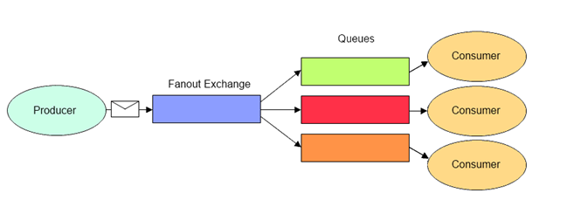
AMQP 0-9-1 Model - Fanout Exchange
The Fanout exchange type routes messages to all bound queues indiscriminately. If a routing key is provided, it will simply be ignored.
The Fanout exchange type is useful for facilitating the publish-subscribe pattern.
If N queues are bound to a fanout exchange, when a new message is published to that exchange a copy of the message is delivered to all N queues. Fanout exchanges are ideal for the broadcast routing of messages.
Where can we use?
Sport news sites can use fanout exchanges for distributing score updates to mobile clients in near real-time
Group chats can distribute messages between participants using a fanout exchange

